Slide 1


Yelp Recommender System
Dao Xiang, Qian Zhang(Angel), Yi Xiao

Slide 2
Outline
What is Recommender System
Why Recommender System
How to design Recommender System
Deployment of recommender system on Spark
Design feature pops

Slide 3

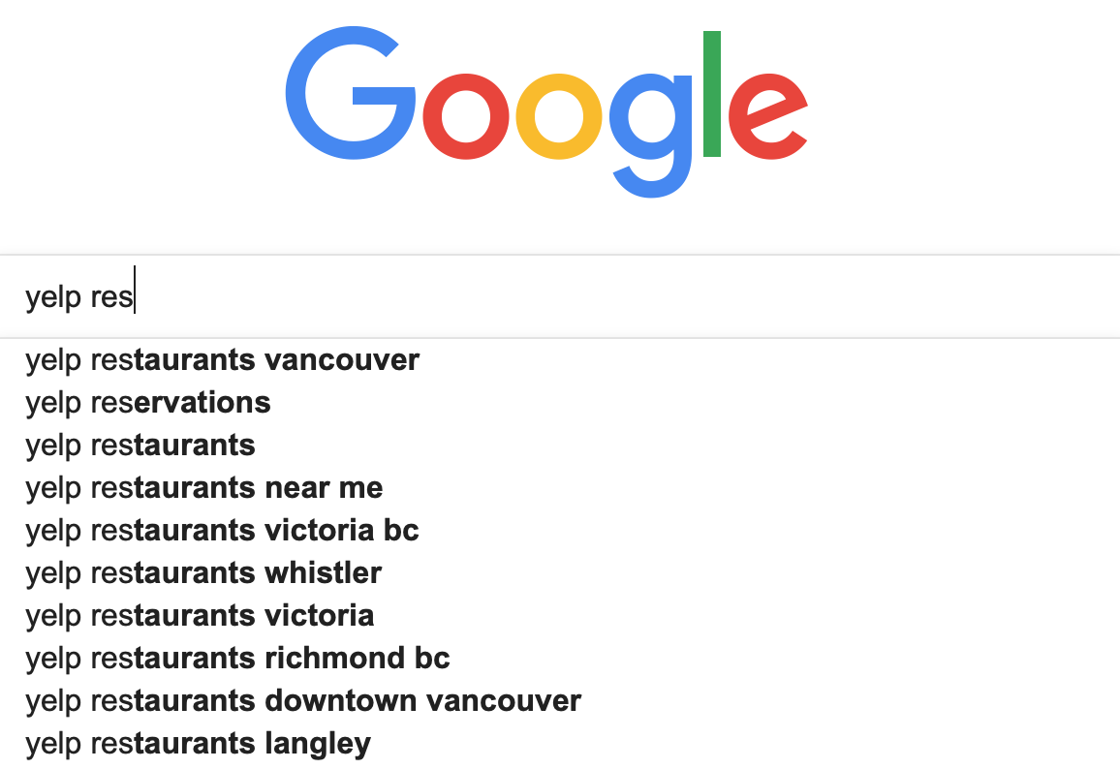
What is recommender system
Systems that attempt to predict item that users may be interested in
Systems that help people find information that may interest them

Slide 4
Why recommender system
Information filtering
Recommendation is the art of prediction, and nowadays when there’s unlimited amounts of data and enormous catalogues of items to select — there is a need for a filter.

Slide 5
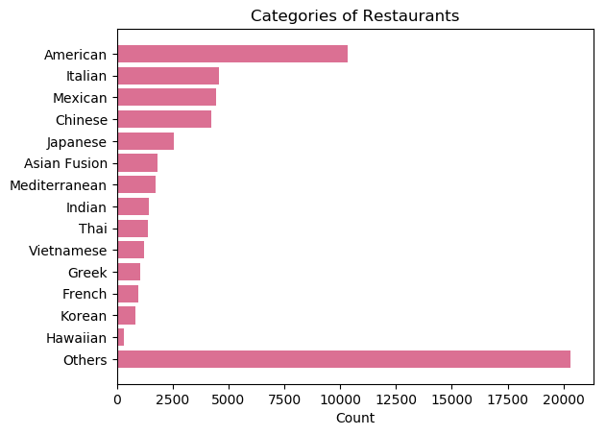
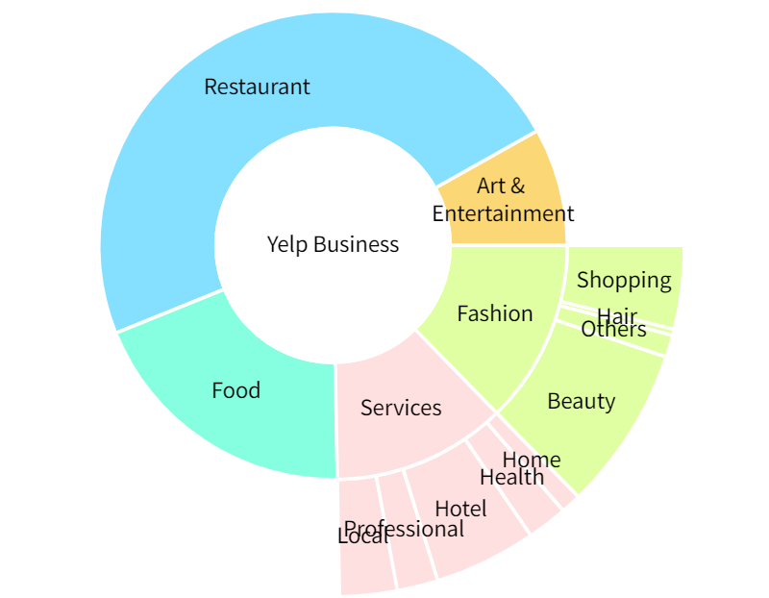
Overview of Yelp Business

Slide 6
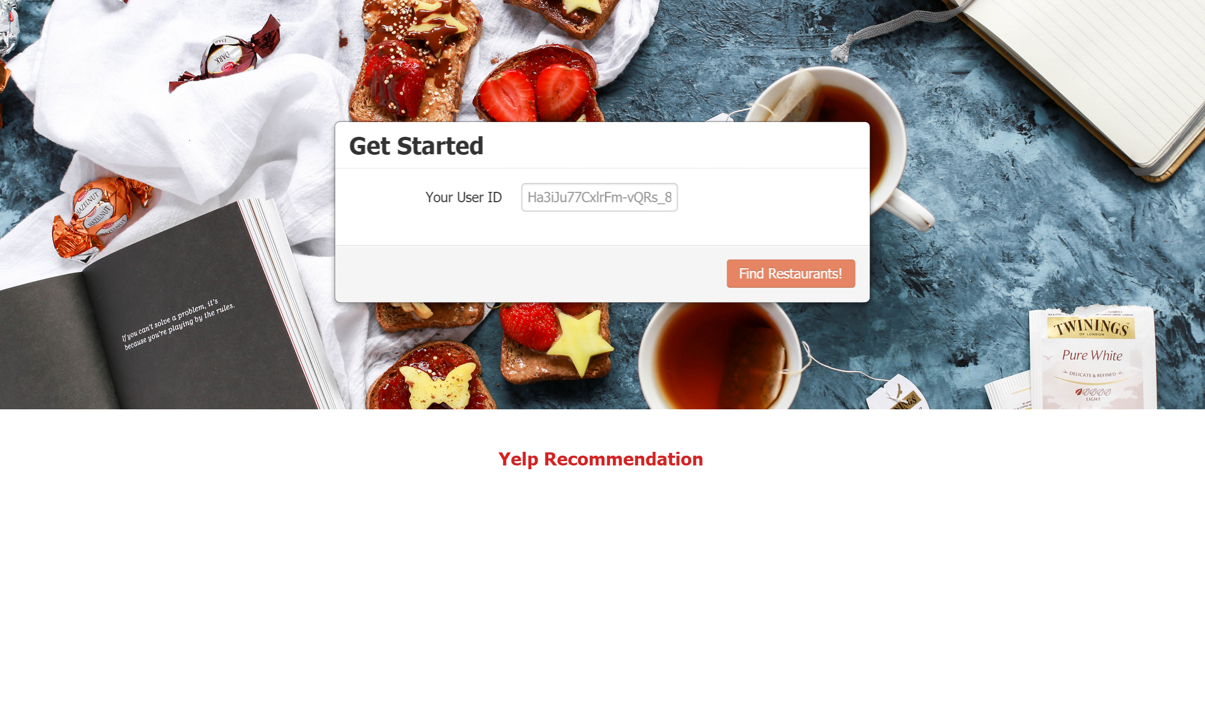
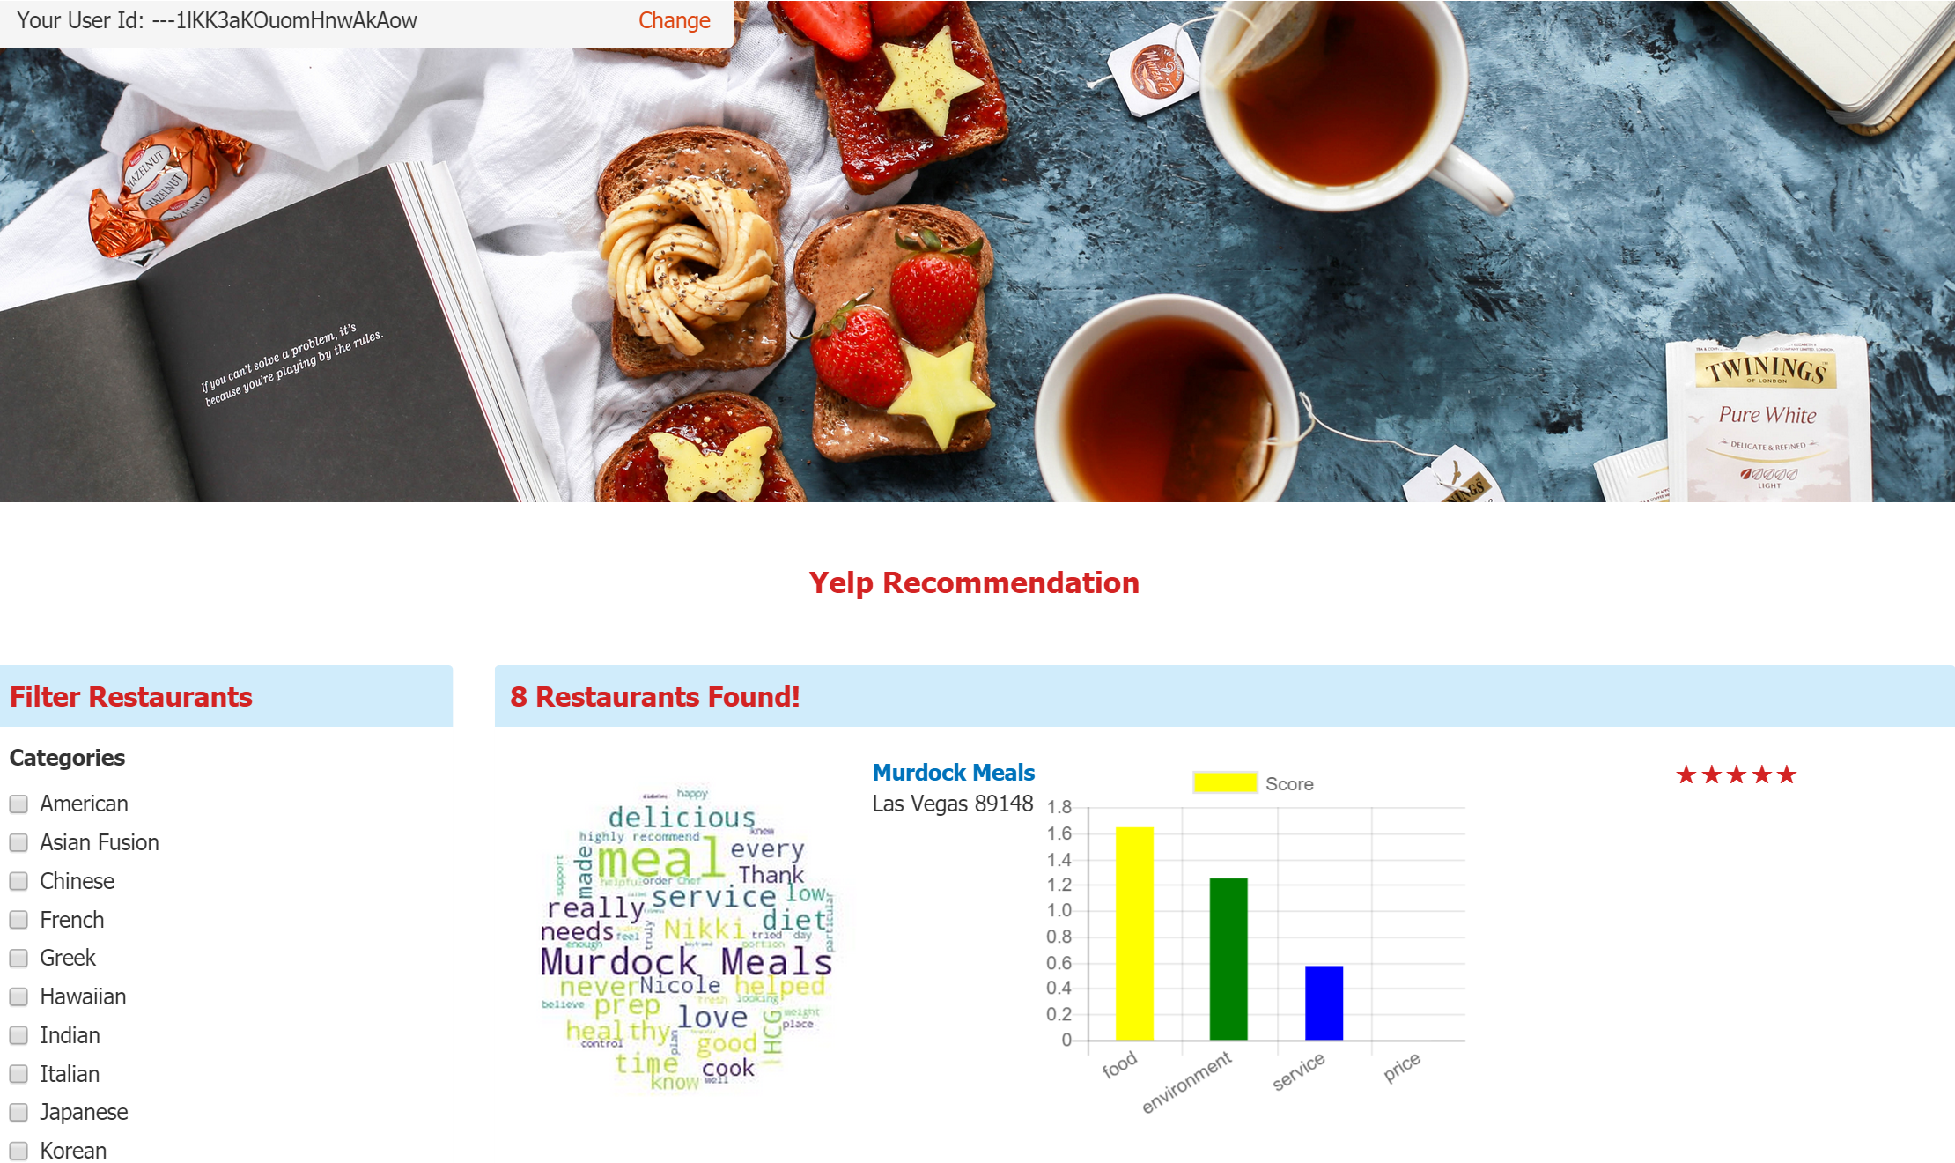
Design Recommender System
Design Yelp Recommender System

Slide 7
Design Recommender System
Algorithms used for recommender system
Choose one algorithm then implement it
Implement recommender system with Spark

Slide 8
Algorithms used for recommender system
User Collaborative Filtering (User CF)
A form of collaborative filtering based on the similarity between users calculated using people's ratings of those items
Item Collaborative Filtering (Item CF)
A form of collaborative filtering based on the similarity between items calculated using people's ratings of those items

Slide 9

Algorithms used for recommender system
We will use Item CF
The number of users weighs more than number of products
Item will not change frequently, lowering calculation

Slide 10
Item CF
Build co-occurrence matrix
Build rating matrix
Matrix computation to get recommending result

Slide 11
Item CF
the first thing to do
Describe the relationship between different restaurants
Based on business.json
business_id
City
State
Based on review.json
user_id
business_id
Stars
text
We will use rating history to build relationship between restaurants
If one user rated two restaurants, these two are related

Slide 12
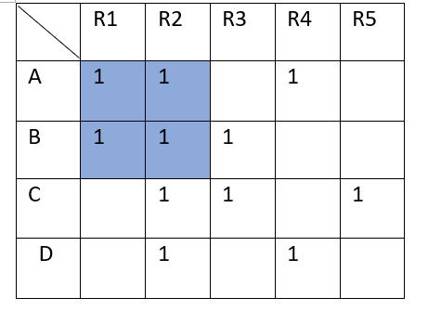
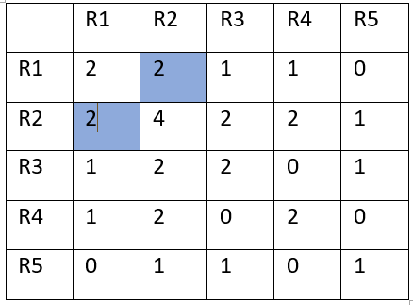
Item CF
Co-occurrence matrix
A co-occurrence matrix is a matrix that is defined over an image to be the distribution of co-occurring pixel values (grayscale values, or colors) at a given offset.
value(R1,R2) = Count(x_R1 && x_R2) x represents that restaurant R1 and restaurant R2 were reviewed by the same customer

Slide 13
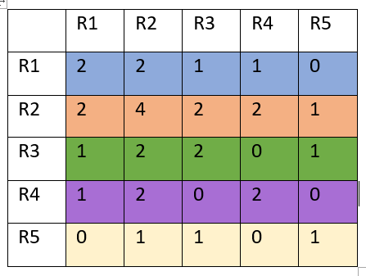
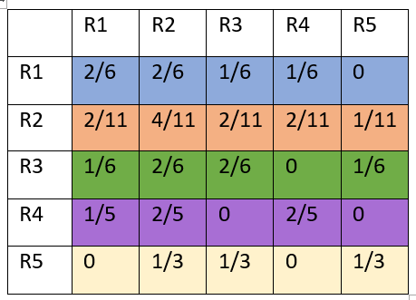
Item CF
Co-occurrence matrix
Normalization

Slide 14
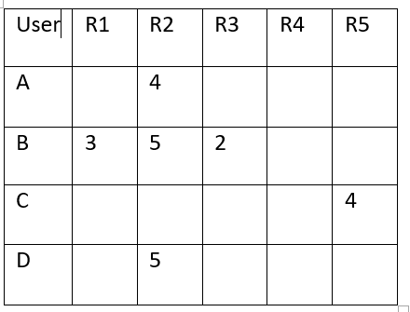
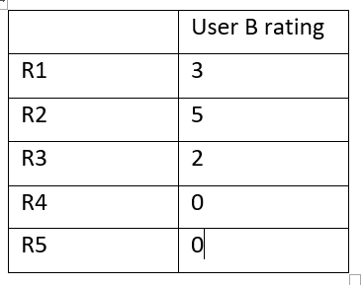
Item CF
Rating matrix
tell the difference between restaurants towards each user

Slide 15
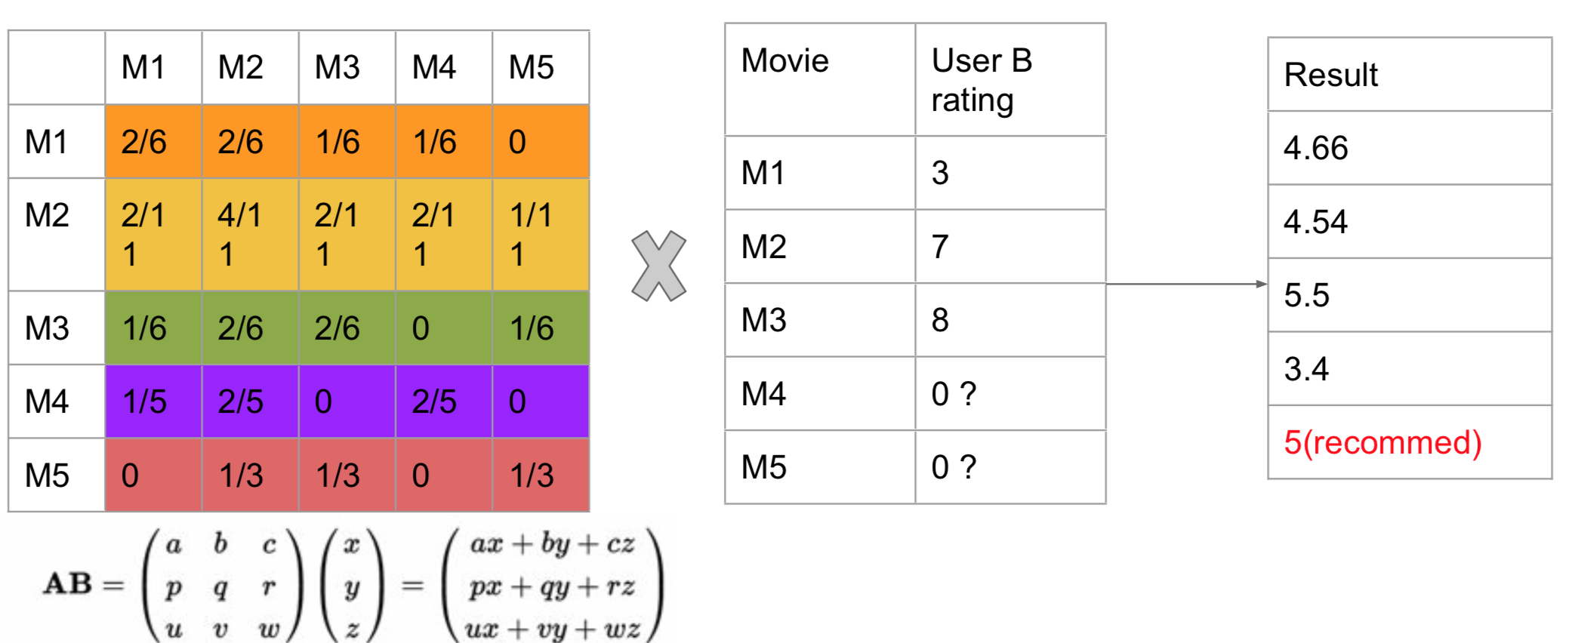
Item CF
Matrix computation to get recommending result
5
2
2.6
2.3

Slide 16
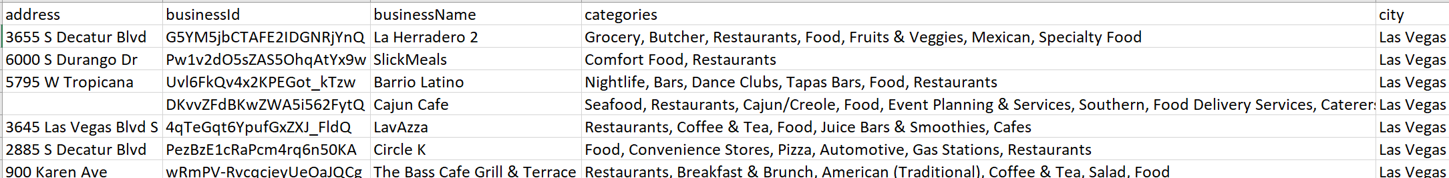
Design Recommender System
Generate recommender list
TopK
userID: zf2GKfO-A-GCCjcq6gtmJw

Slide 17
Design Feature Pops
Nltk: Wordnet, sentiwordnet
pyspark.ml: RegexTokenizer, StopWordsRemover
synset
senti_synset
Good pos_score 0.75

Slide 18
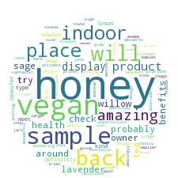
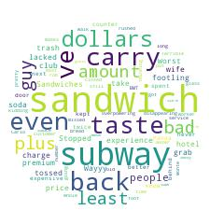
Design Feature Pops
"Great place to hang out after work: the prices are decent, and the ambience is funny. The staff is friendly, and the food is good. They have a good selection of drinks."
"Great place price decent ambience funny staff friendly food good good drink”
"Great place price decent ambience funny staff friendly food good good drink"

Slide 19
Design Feature Pops
“Great place price decent ambience funny staff friendly food good good drink”
place: [‘point’, ‘location’, ‘object’, ‘physical_entity’, ‘entity’] -> environment
price -> price
ambience: ['condition', 'state', 'attribute', 'abstraction', 'entity'] -> environment
staff -> service
food -> food
drink -> food

Slide 20
Design Feature Pops
"Great place price decent ambience fun staff friendly food good good drink”
"Great environment price decent environment fun service friendly food good good drink”
Environment: Great, 0; funny, 0.5 -> 0.25
Price: decent, 0.875 -> 0.875
Service: friendly, 0.25 -> 0.25
Food: good, 0.75; good, 0.75 -> 0.75

Slide 21
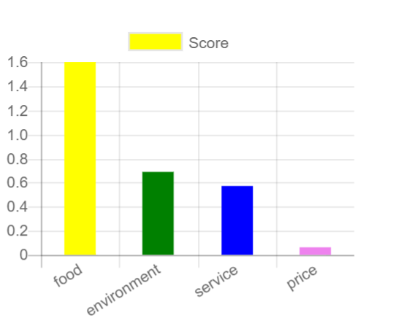
Design Feature Pops
Environment: 0.25 * stars
Price: decent, 0.875 * stars
Service: 0.25 * stars
Food: 0.75 * stars

Slide 22

Thanks for your interest!

